Slide 1

Comp90042
Workshop
Week 9
18 May
1
Notes:
1

Slide 2
Table of Contents
Probabilistic context-free grammar
Probabilistic CYK parsing vs. CYK parsing
Dependency parsing
(transition-based, probabilistic) dependency parsing vs. (probabilistic) CYK parsing
2

Slide 3
Probabilistic context-free grammar
What is a probabilistic context-free grammar and what problem does it attempt to solve?
A probabilistic context-free grammar adds probability to each production rule in the context-free grammar.
Provides a "language model" to describe the likely sentences in a language.
3
Notes:
A probabilistic context-free grammar adds real-valued weights (probability)
to each production in the context-free grammar. This attempts to provide a
“language model”, that is, describe the likely sentences in a language, which
is facilitated by their grammatical structure.

Slide 4
Probabilistic CYK parsing vs CYK parsing
What differentiates probabilistic CYK parsing from CYK parsing? Why is this important? How does this affect the algorithms used for parsing?
Parsing: the process of identifying the structure(s) of a sentence, according to a grammar of the language.
Dynamic programming: large search space
Chart: CYK: partial parses (licensed structures) for various spans (sequences of tokens) ; Probabilistic CYK: additionally, probabilities of production rules
Important: differentiate likely parses from unlikely ones
Affect: need to track the maximum probability analysis for each span, rather than the set of grammar symbols
4
Notes:
Parsing in general is the process of identifying the structure(s) of a sentence,
according to a grammar of the language.
In general, the search space is too large to do this efficiently, so we use a
dynamic programming method to keep track of partial solutions. The data
structure we use for this is a chart in CYK, where entries in the chart correspond
to partial parses (licensed structures) for various spans (sequences
of tokens) within the sentence. Probabilistic CYK parsing adds real-valued
weights (probability) to each production in the grammar, such that parse trees
can be assigned a score, namely the product of the probabilities of the productions
in the tree. This is important as it allows for discrimination between
likely and unlikely parses, rather than just provide a list of all parses, as in
standard CYK parsing. This affects the algorithms as they need to track the
maximum probability analysis for each span, rather than the set of grammar
symbols. However the parsing algorithms are very closely related.
4

Slide 5
HMM to CFG
A hidden Markov model assigns each word in a sentence with a tag, e.g.,
Donald/NNP has/VBZ small/JJ hands/NNS
The probability of the sequence is based on the tag-word pairs, and the pairs of adjacent tags. Show how this process can be framed as a CFG, and how various probabilities (e.g., observation, transition, and initial state) can be assigned to prodoctions. What are the similarities and differences between CYK parsing with this grammar, and HMM's Viterbi algorithm for finding the best scoring state sequence?
5

Slide 6
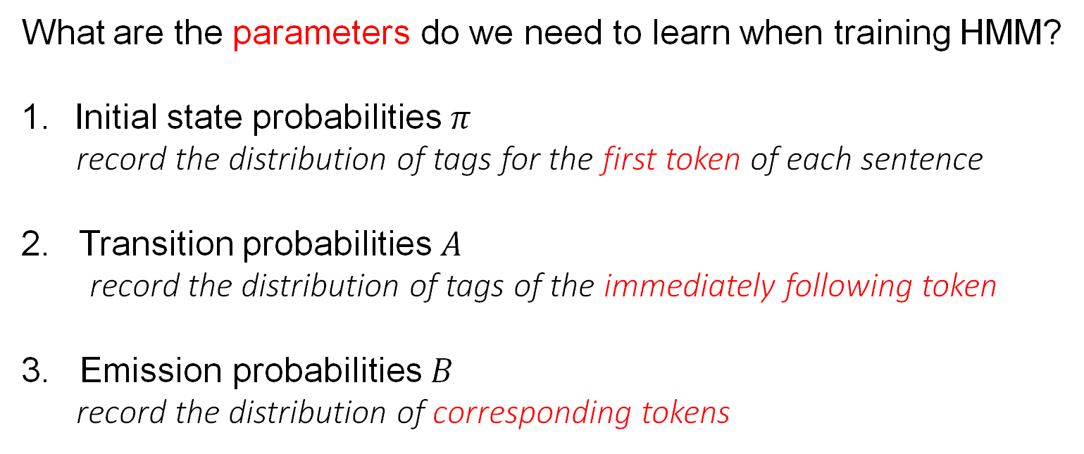
Hidden Markov Revisiting
What are the parameters do we need to learn when training HMM?
Initial state probabilities $π$
record the distribution of tags for the first token of each sentence
2. Transition probabilities $A$
record the distribution of tags of the immediately following token
3. Emission probabilities $B$
record the distribution of corresponding tokens

Slide 7
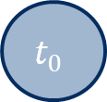
HMM
Donald/NNP has/VBZ small/JJ hands/NNS
Visualize the HMM
$$t_{0}$$
NNP
VBZ
JJ
NNS
Donald
has
small
hands

Slide 8
HMM to CFG
1: The first step is to write the probability assigned by the HMM to the tagged sentence
2: this can be drawn as a chain with the tag-tag transitions as the "spine", with each observation as a leaf. The probabilities of initial/transition/observations can be attached to each edge, resulting in a right-branching tree.
3: treating as a "parse tree", each clique from the tree (parent and direct children) can be treated as a CFG rule, parent left-child right-child, e.g., NNP Donald VBZ
4: The score for this rule is ANNP,VBZ times ONNP,Donald . Note that we could use different grammar symbols, such that each production maps to a single HMM component.
5. CYK parsing under this grammar is the same as Viterbi in HMM, with extra waste effort assigning analysis to all word spans in the sentence, while Viterbi only considers spans that start at the first word of the sentence
8
Notes:
The first step is to write the probability assigned by the HMM to the tagged
sentence.
This can be drawn as a chain with the tag-tag transitions as the “spine”, with
each observation as a leaf. The probabilities of initial / transitions / observations
can be attached to each edge. Overall this gives a right-branching
tree.
If we treat this tree as a “parse tree”, then each clique from the tree (parent
and direct children) can be treated as a CFG rule, parent ! left-child rightchild.
E.g., NNP! Donald VBZ.
The score for this rule would be ANNP,VBZ ONNP,Donald. Note that we could
use different grammar symbols, such that each production maps to a single
HMM component. E.g., split the above rule to NNP’!NNP VBZ (ANNP,VBZ);
and NNP ! Donald (ONNP,Donald); where the “prime” version of the tag is a
newly introduced grammar symbol.
CYK parsing under this grammar will do the same as Viterbi in the HMM,
but will waste effort assigning analysis to all word spans in the sentence,
while Viterbi effectively only considers spans that start at the first word of
the sentence.

Slide 9
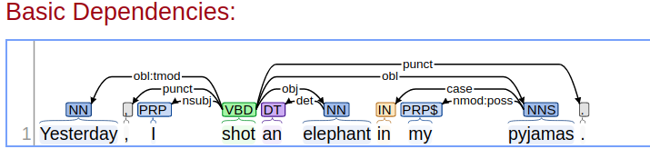
Dependency Parsing
Using typical dependency types, construct (by hand) a dependency parse for the following sentence: Yesterday, I shot an elephant in my pyjamas. Check your work against the output of the online GUI for the Stanford Parser: https://corenlp.run/
9

Slide 10
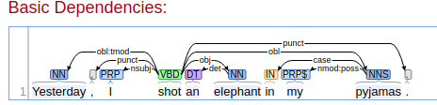
Dependency Parsing
ID Token Head Relation
1 Yesterday 4 OBL:TMOD
2 , 4 PUNCT
3 I 4 NSUBJ
4 shot 0 ROOT
5 an 6 DET
6 elephant 4 DOBJ
7 in 9 CASE
8 my 9 POSS
9 pyjamas 4 OBL
10 . 4 PUNCT for description of relations: https://universaldependencies.org/u/dep/
10

Slide 11
(probabilistic) dependency parsing vs. (probabilistic) CYK parsing
In what ways is (transition-based, probabilistic) dependency parsing similar to (probabilistic) CYK parsing? In what ways is it different?
Similarity:
(1) determine the structure of a sentence;
(2) attempt to disambiguate among the (perhaps many) possible structures licensed by the grammar using a probabilistic grammar;
(3) process the tokens in the sentence one-by-one, left-to-right
11

Slide 12
(probabilistic) dependency parsing vs. (probabilistic) CYK parsing
In what ways is (transition-based, probabilistic) dependency parsing similar to (probabilistic) CYK parsing? In what ways is it different?
Differences:
(1) Although POS tags are implicitly used in constructing the "oracle" (training), the dependency parser does not explicitly tag the sentence;
(2) The dependency parser can potentially take into account other (non-local) relations in the sentence, whereas CYK's probabilities only depend on the (local) sub-tree;
(3) CYK add numerous fragments to the chart, not used in the final parse, whereas the transition-based dependency parser only adds edges used in the final structure.
12
Notes:
There are numerous differences (probably too many to enumerate here), for
example:
– Although POS tags are implicitly used in constructing the “oracle” (training),
the depedency parser doesn’t explicitly tag the sentence.
– The transition–based dependency parser can potentially take into account
other (non–local) relations in the sentence, whereas CYK’s probabilities
depend only on the (local) sub-tree.
– CYK adds numerous fragments to the chart, which don’t end up getting
used in the final parse structure, whereas the transition–based dependency
parser only adds edges that will be in the final structure.

Slide 13
Takeaways
Probabilistic context-free grammar
Probabilistic CYK parsing vs. CYK parsing
Dependency parsing
(transition-based, probabilistic) dependency parsing vs. (probabilistic) CYK parsing
13

